Slide 1
HTML
DIV
ELEMENT
The <div></div> element is used as a container for other HTML elements.
The div is a content division tag.

Slide 2
HTML Div Element: Grouping webpage contents
The div tag is a generic block-level element which can be used to create blocks on your web page.
Unlike other block level elements that are used in placing texts (which we studied earlier), the purpose of the div tag is in grouping web contents.
Grouping web page contents makes it easier to apply style to the HTML elements all at once. The font-size property can be applied to the header div and all the p tags within it obey!
<div></div>
The <div> element is used as a container for other HTML elements.

Slide 3
THE CONTENTS DIVISION TAG (DIV)
The boxes, just like lego blocks can be put together to form a complete website.
DIVs make your webpage to be sectionalized.
Styling the div on your web page is the basis of web page layout when creating your website. You can apply the width and height style to create divs of different shapes and sizes
Achieve the layout shown:
<div>
<h2>Lagos</h2>
<p>Lagos is the commercial city of Nigeria.</p>
<p>Lagos has over 13 million inhabitants.</p>
</div>

Slide 4
Lagos
Lagos is the commercial city of Nigeria
Lagos has over 13 million inhabitants.
BLOCK LEVEL OF A DIV
A <div> element takes up all available width:
text before div <div>I am a div</div> text after div
text before div
I am a div
text after div
The <div> element has no required attributes, but style, class and id are common.

Slide 5

SAMPLE WEBSITE AND THE USE OF DIV TAG TO SECTIONALIZE THE PAGE
(SEE COLOR DEMARCATION)

Slide 6
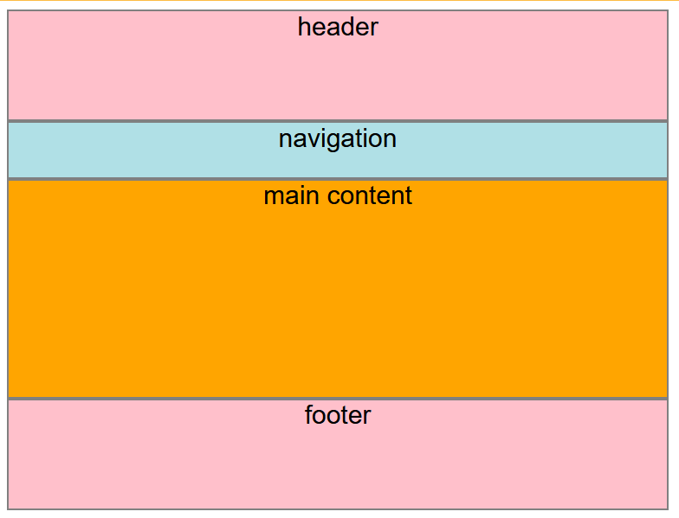
Class exercise:
Kindly achieve the following using div tags and style attribute

Slide 7
PLACING DIVS SIDE BY SIDE
Recall that the DIV tag is a block level element.
DIVs are important in grouping the different parts of our website as we saw earlier
From everything we have learnt so far, how do you think we can achieve placing div side by side? Float property or course!
Most website design go beyond just placing divs over another
What if we wish to place this blocks side by side? Let’s try to reduce the width and see if they will stand side by side…
Lets look at four ways to achieve this.

Slide 8
SEMANTIC HTML ELEMENTS
A semantic element clearly describes its meaning to both the browser and the developer.
Examples of non-semantic elements: <div> and <span> - Tells nothing about its content.
Examples of semantic elements: <img>, <table>, and <article> - Clearly defines its content.
<article>
<aside>
<details>
<figcaption>
<figure>
<footer>
<header>
<main>
<mark>
<nav>
<section>
<summary>
<time>

Slide 9
<main>
<header>
<h1 style="background-color: lightcoral;">E-Shop</h1>
<nav>
<ul >
<li></li>
<li></li>
<li></li>
<li></li>
</ul>
</nav>
</header>
<section style="background-color: lightblue;">
<h2>Main website body</h2>
<span>I am a span within the body div</span>
</section>
<article>
<h2>Article section</h2>
<p>This is a paragraph within the article section.</p>
</article>
<footer style="background-color: lightgreen;">
<h3>Footer section</h3>
</footer>
</main>
Semantic HTML tags properly used to section a web page ensuring each section being clearly explained with the tag.

